Slide 1

ORIENT ai
A research-driven investigation into vocational disorientation and a Machine Learning solution to fix it.
Team 7
Aroa Aguiño Domínguez, Naroa Genicio Iglesias, María Encina Díez del Río,
Mario Fernández Costello, Jaime Esteban Reano, Jorge Domínguez Palomo and David Sánchez Sánchez
Notes:
mario
Hello everyone, we are Team 7. Our project is called ORIENT AI.
We’re here to address a problem that is incredibly common, yet almost always underestimated: how students choose their academic future.

Slide 2

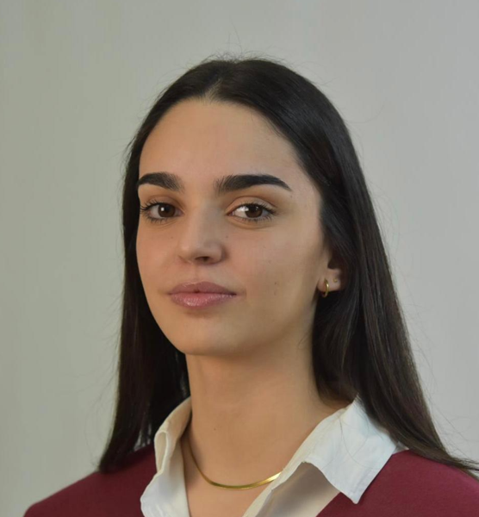
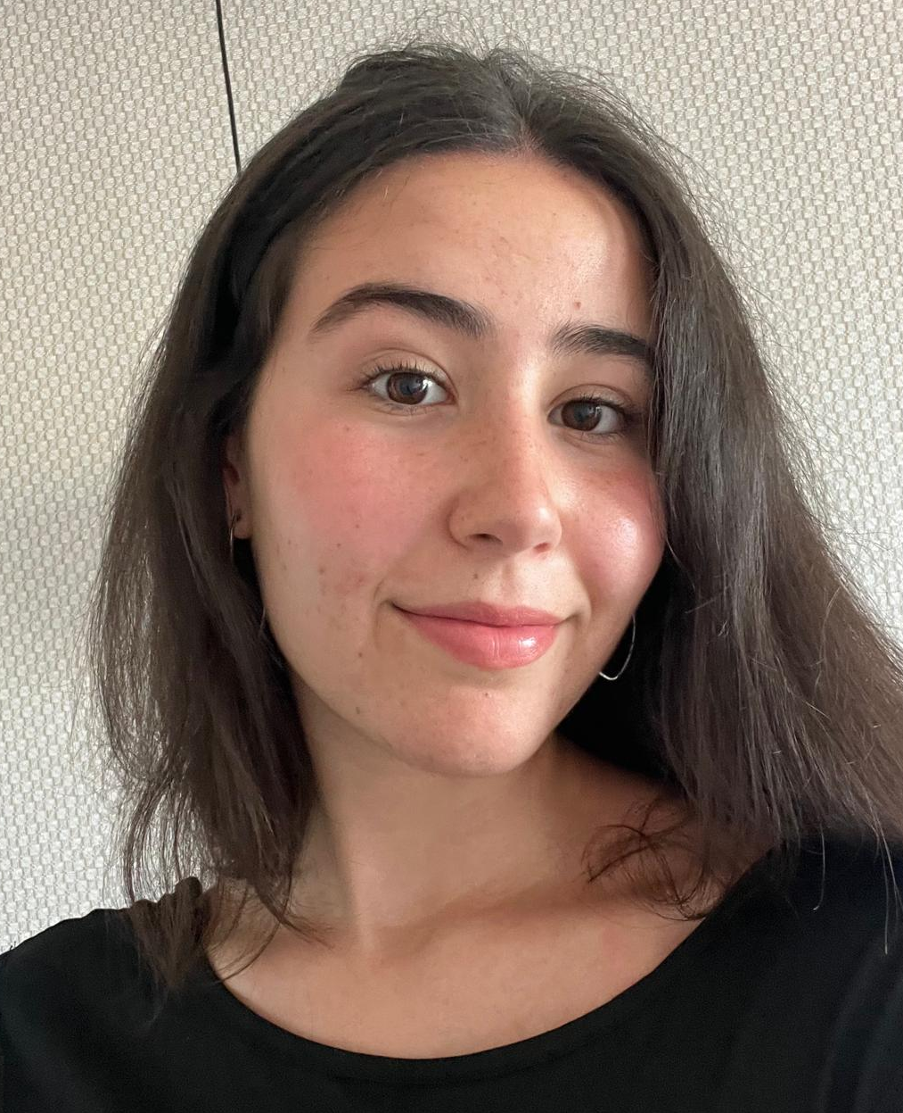
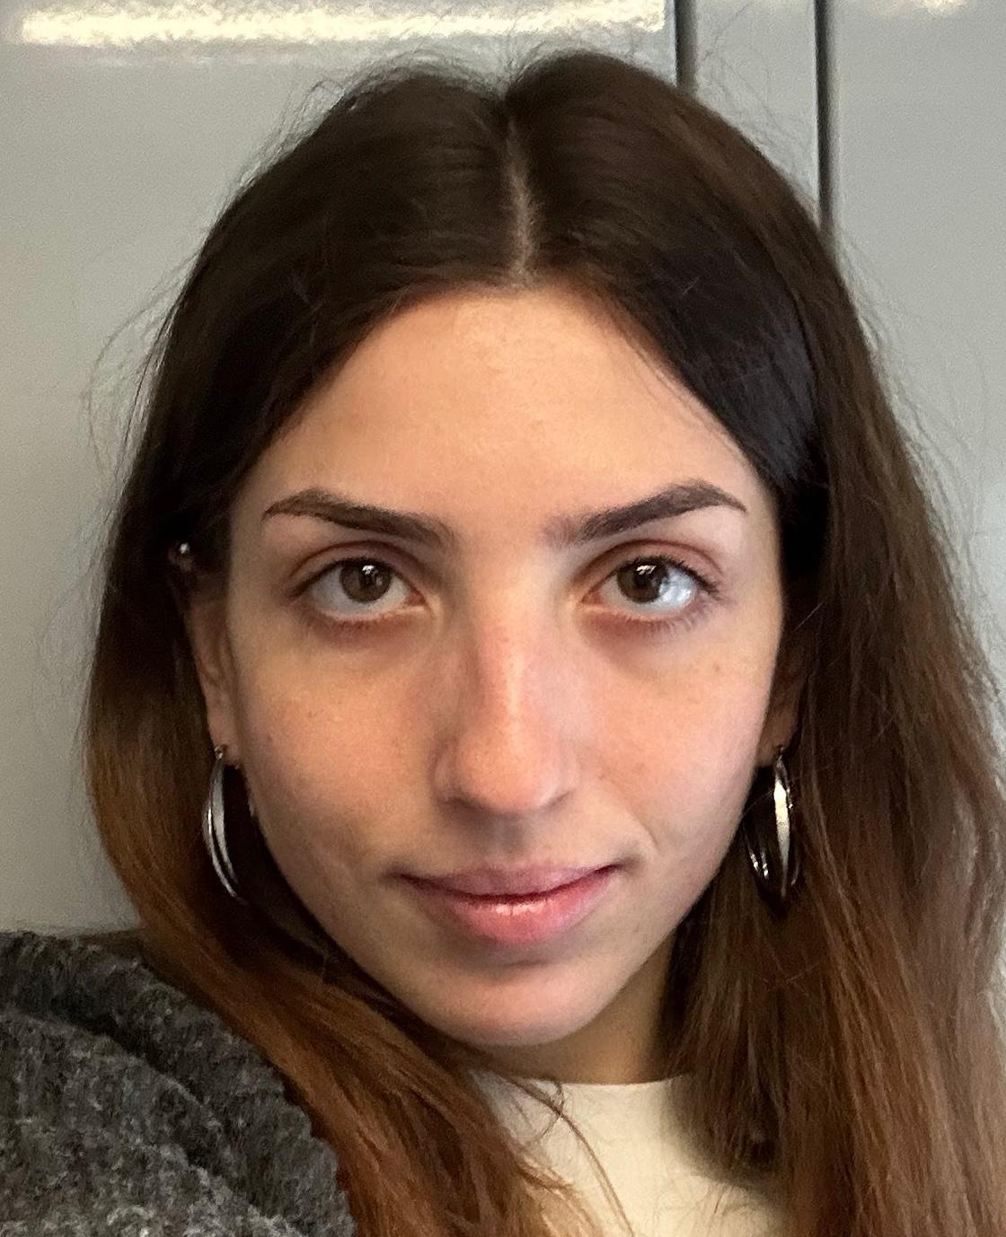


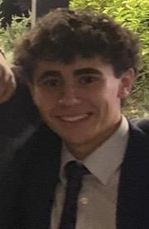

Aroa Aguiño Domínguez
Naroa Genicio Iglesias
María Encina Díez del Río
Mario Fernández Costello
Jaime Esteban Reano
Jorge Domínguez Palomo
David Sánchez Sánchez
Notes:
mario Before we dive in, I’d like to introduce you to the team.
We are Aroa, Naroa, María Encina, Mario, Jaime, Jorge, and David.
We are all Erasmus students from Spain, and arriving here in Lodz gave us a fresh perspective on this issue.

Slide 3
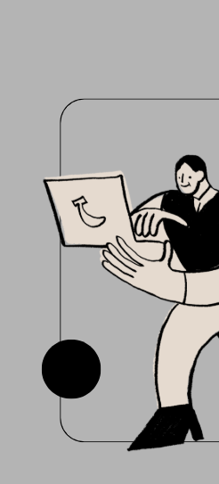

A Systemic Crisis, Not A Personal One
This project began through informal conversations with students at the
Politechnika University of Lodz.
Across different faculties, a common pattern emerged: most students
felt lost, overwhelmed, and disoriented when choosing their degree.
The transition from high school to university was described as:
Stressful
Uncertain
Blind decisions
Many students choose their degree due to:
External pressure (family, expectations)
Lack of guidance
Process of elimination
We identified a systemic failure in career guidance
2
Notes:
mario
What we discovered—and you can see this on the slide—is that this isn't just an individual struggle. It’s a systemic one.
While we’ve been living and studying here in Lodz, we’ve had dozens of informal conversations with fellow students at the Politechnika.
Across every faculty, we found the exact same pattern. Students described their transition from high school to university using three words: Stressful, Uncertain, and Blind.
Most people aren't choosing their degrees because they have a deep passion for the subject. Instead, they’re feeling the weight of external pressure from family, a total lack of guidance from their schools, or they are simply eliminating options until only one is left.
We realized we weren't just looking at stressed students; we were looking at a systemic failure in career guidance.

Slide 4


VALIDATING THE PROBLEM
Is This Still Happening today?
This is not a past issue, it is a current and ongoing problem
3
Notes:
mario
So we asked ourselves: Is this still happening everywhere today, or were these just a few isolated cases?
That led us to the next step: checking if we were right using real data.
To show you how we went from those first conversations to actual facts, Jaime will take over.

Slide 5
VALIDATING THE PROBLEM
To validate our hypothesis, we reached out to current High School students in Spain and the Polytechnic University. Their feedback was clear:
They experience the same confusion and frustration
They feel unsupported by traditional guidance systems
Despite digitalization, career orientation methods:
Have not evolved
Do not adapt to students’ real needs
This is not a past issue, it is a current and ongoing problem
4
Notes:
jaime
To validate our hypothesis, we contacted both high school students and university students. The feedback was very consistent: students still feel confused and unsupported
and current guidance systems have not evolved, they do not adapt to real student needs.

Slide 6
FROM INSIGHT TO DATA
To move from observation to data, we created a survey:
Distributed:
Via Google Forms
Target:
High School students currently choosing their future
Shared:
Through our former high schools in Spain
Delivered:
Directly in classrooms via teachers and counselors
Ensured a reliable and relevant sample
5
Notes:
jaime
To move from qualitative observations to quantitative data, we designed a structured survey. We distributed it through Google Forms,
targeting high school students currently choosing their future. It was shared through our former schools and even delivered directly in classrooms,
ensuring a relevant and reliable sample.

Slide 7

SURVEY
Main objectives of the Survey:
Assess Trust in Guidance Systems
Measure Decision Fatigue
Identify the “Satisfaction Gap”
How overwhelmed students feel with current tests
Do existing tools reflect their real interests?
Fear of choosing something that doesn’t make them happy
6
Notes:
jaime
The survey had three main objectives: First, measure decision fatigue, how overwhelmed students feel. Second, assess trust in current guidance systems.
And third, identify what we call the ‘satisfaction gap’, the fear of choosing something that won’t make them happy. Now, let’s look at what we actually found.

Slide 8
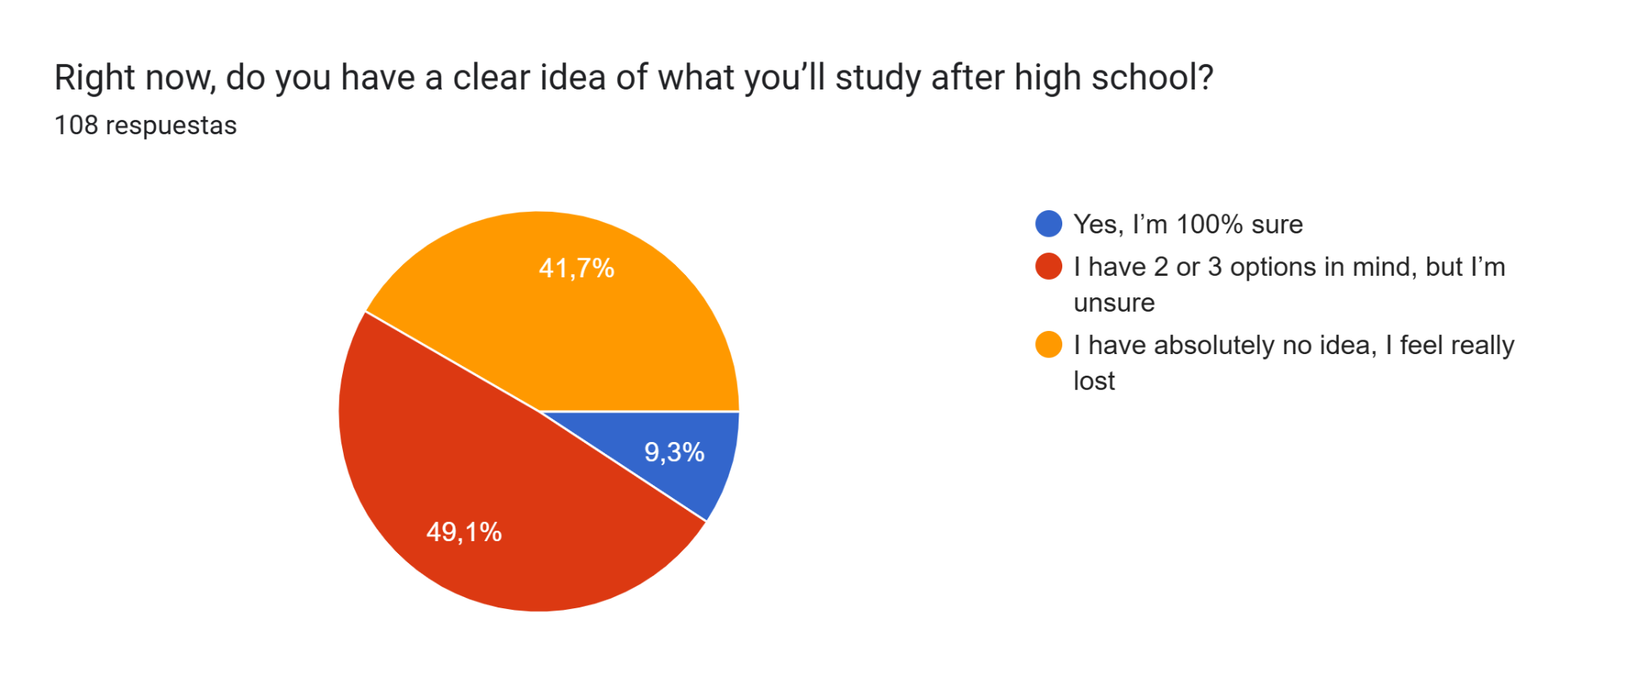
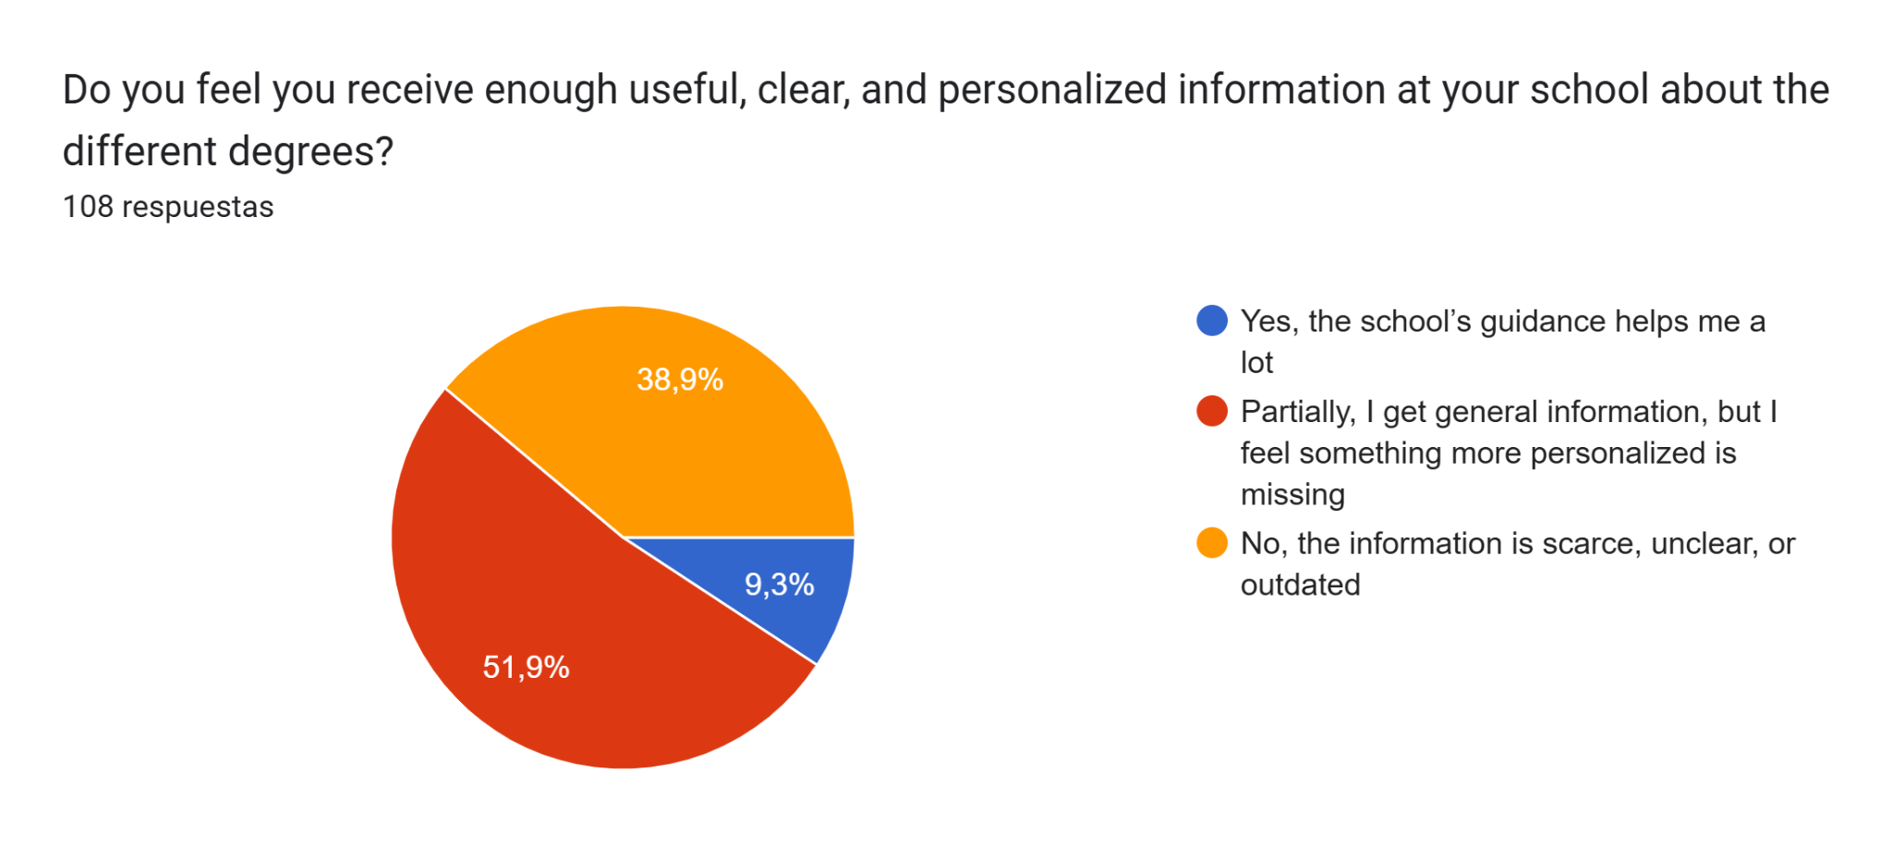
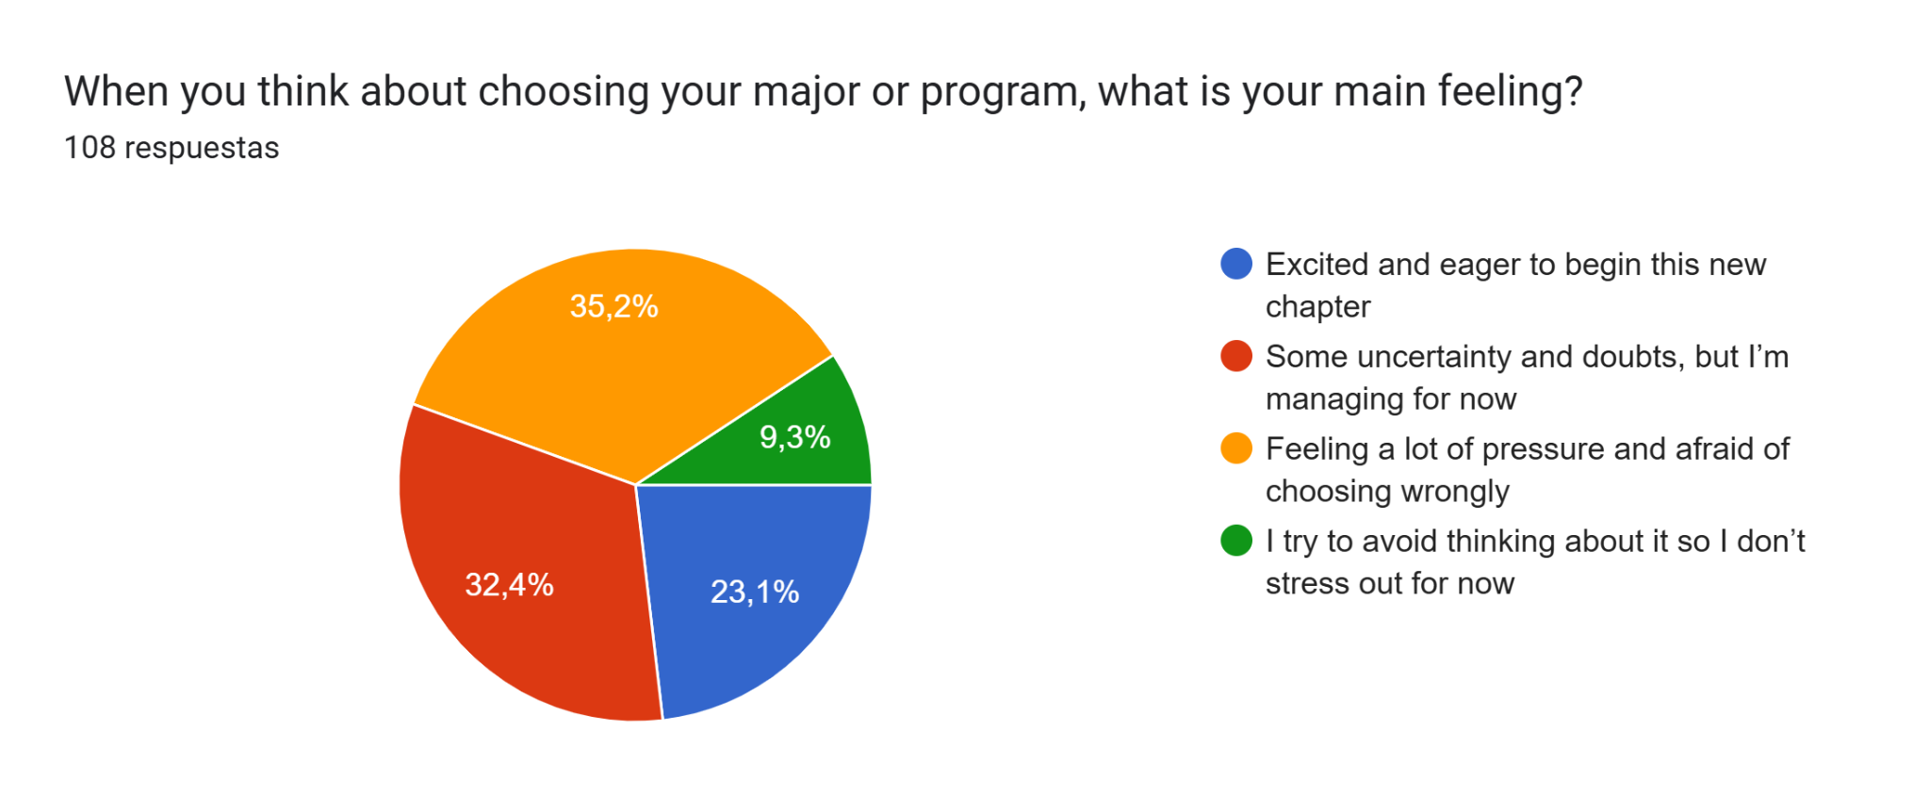
Survey Results: 108 Students
7
Notes:
So, in these slides we present the results of a survey conducted with 108 high school students about how they feel when choosing their future degree.
First of all, we can see a clear lack of certainty. Only 9.3% of students say they are completely sure about what they want to study. Meanwhile, almost half of them have several options but feel unsure, and a large percentage say they have no idea at all.
When it comes to the information they receive, more than half of the students feel that it is not enough or not personalized. This suggests that the problem is not only indecision, but also a lack of proper guidance

Slide 9
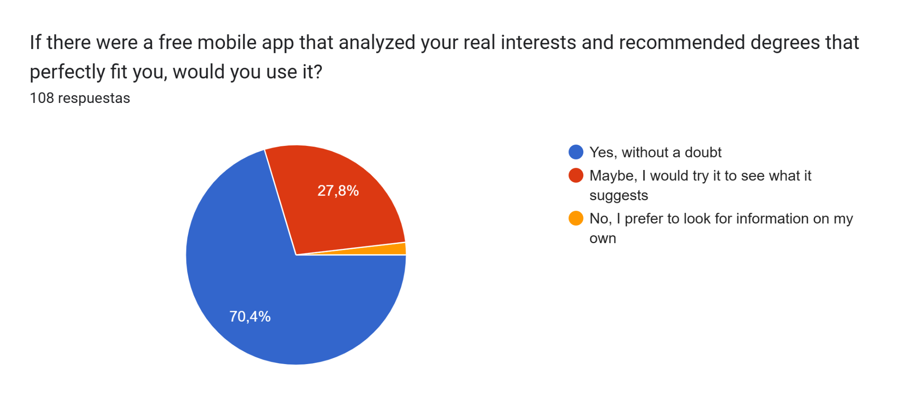

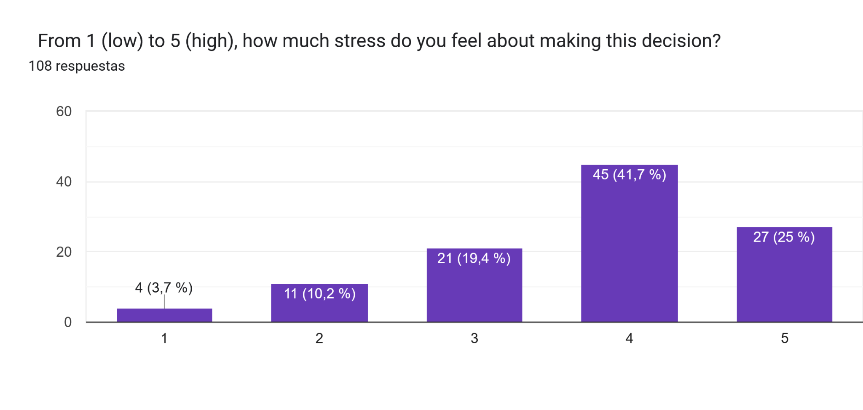
Survey Results: 108 Students
KEY FINDINGS
66% report high stress levels when choosing a degree
70% would use a mobile app
8
Notes:
Looking at their emotions, the situation is even more concerning. Around 66% report high levels of stress when making this decision. Many students also feel pressure and fear of choosing the wrong path, and some even avoid thinking about it because it causes anxiety.
However, there is an interesting insight: more than 70% of students said they would use a mobile app that helps them find the right degree based on their interests.

Slide 10
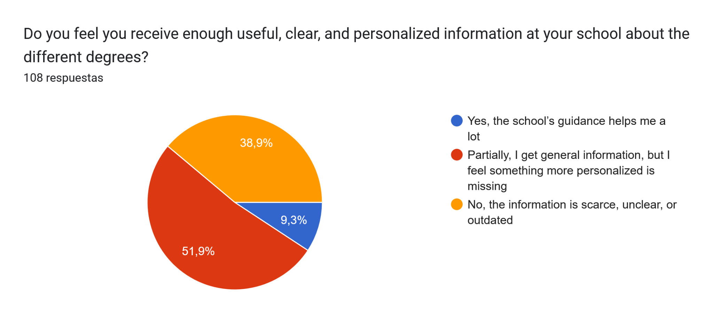
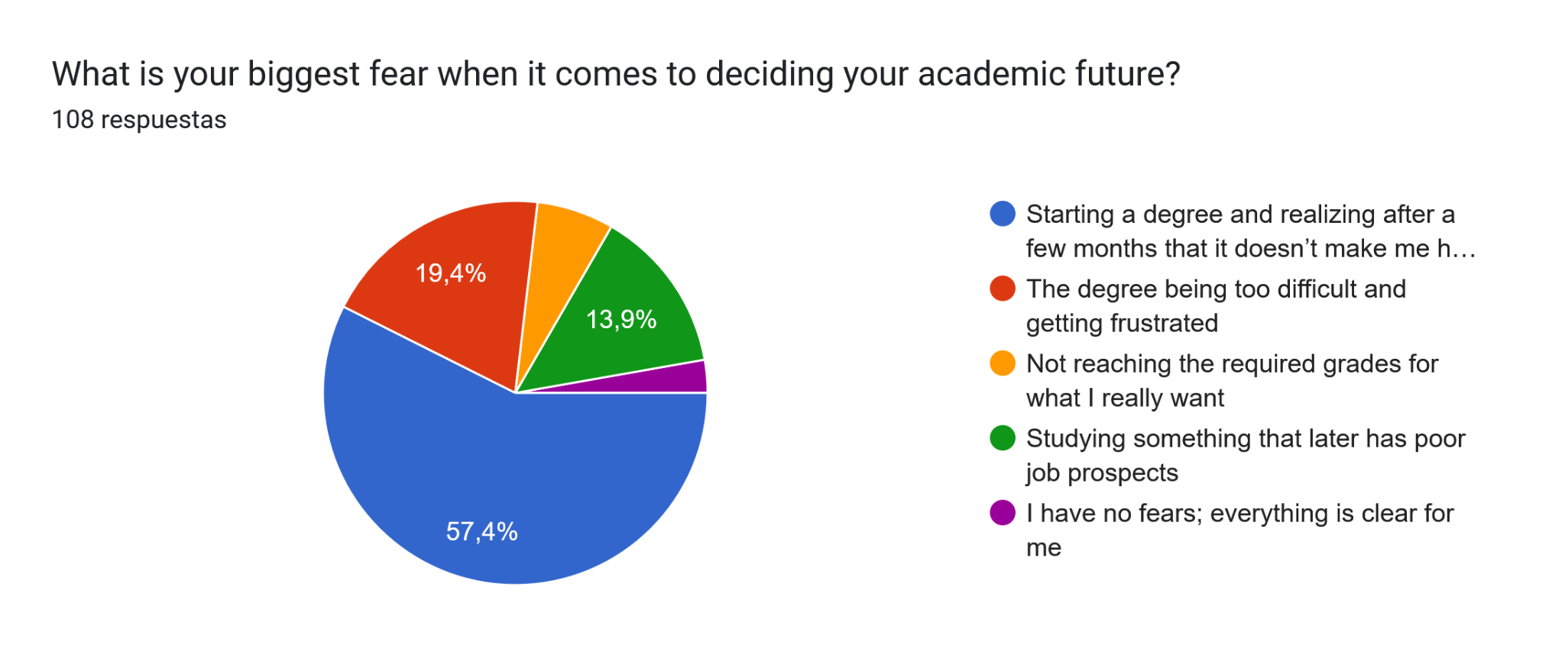
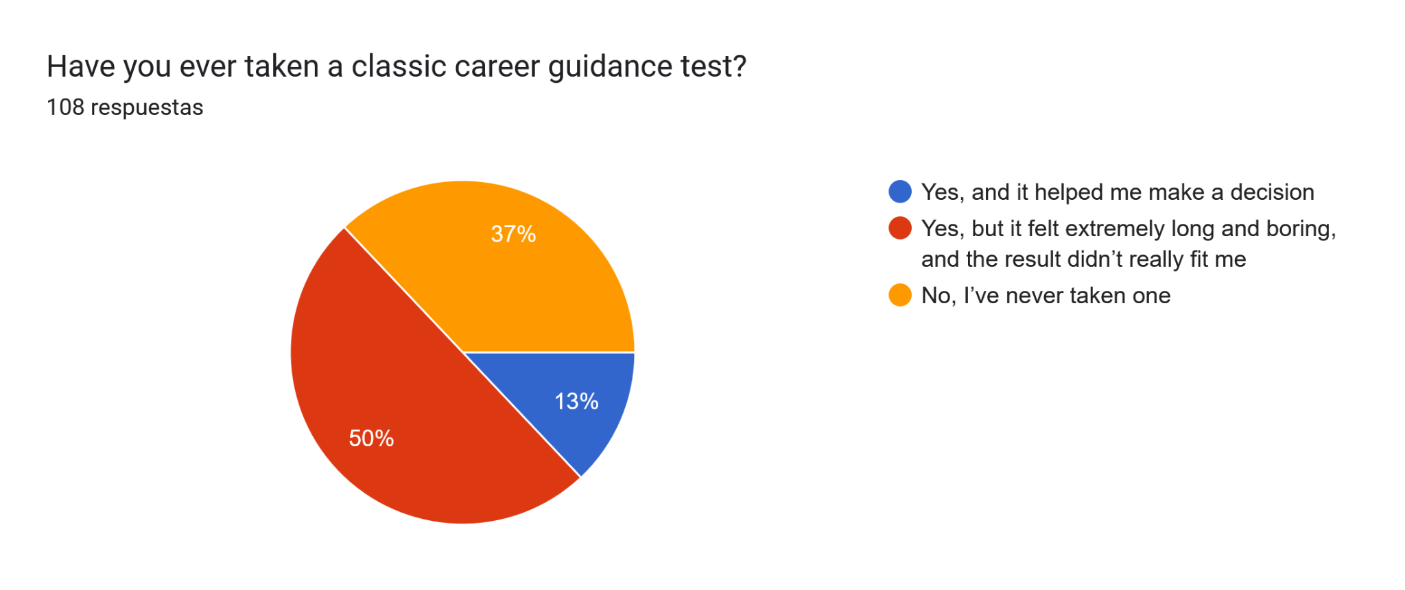
Failure of Current Systems
Survey Results: 108 Students
Core Fear Driving Decisions
The problem is not only choosing, it is choosing “wrong”
Current tools generate decision fatigue instead of clarity
9
Notes:
Let's look at the survey results from 108 students. The data shows a very clear problem.
First, we looked at what drives their decisions. A massive 57% said their biggest fear is starting a degree and realizing later that it doesn't make them happy. The real problem isn't just making a choice—it's the fear of making the wrong choice.
Second, our current guidance systems are failing them. Only 9% of students feel their school gives them enough helpful guidance. The vast majority feel the information is too general, scarce, or outdated.
What about classic career tests? Half of the students said these tests are just long and boring, and the results didn't fit them at all.
In conclusion, our current tools are generating decision fatigue instead of giving students the clarity they really need."

Slide 11

Strong Demand for a New Solution
70.1% would use an app that uses AI to recommend a degree and predict a 'Satisfaction Index' (e.g., 85% likelihood of happiness/not dropping out).
76.6% find AI-based satisfaction prediction “incredible”
90.7% prefer a dynamic, fast experience
We can see a clear demand for a personalized, intelligent, and efficient tool
10
Notes:
"Moving on, our data proves there is a strong demand for a completely new solution.
First, 70.1% of students told us they would use an app powered by AI to recommend a degree. Specifically, they want what we call a 'Satisfaction Index'—a feature that predicts their chances of being happy and not dropping out.
Second, the reaction to this idea is extremely positive. 76.6% of students said they find the concept of AI predicting their satisfaction to be absolutely 'incredible.'
Finally, a massive 90.7% stated they prefer an experience that is fast and dynamic, rather than taking long, traditional tests.
So, the conclusion is clear. Students don't want the old systems. There is a huge demand for a tool that is personalized, intelligent, and highly efficient."

Slide 12
State of the Art: 2025–2026
Pymetrics (Neuroscience-Based)
Method: Uses neuroscience games and AI to assess cognitive and emotional traits.
Goal: Matches users with roles where similar profiles have succeeded.
Kickresume (AI Career Coach)
Method: Analyzes resumes using LLMs (Large Language Models).
Goal: Identifies skill gaps and suggests career paths for professional transitions.
AICareerCoach.org (Conversational Mentor)
Method: A free, chatbot-style tool by CareerVillage.
Goal: Acts as a mentor for students to explore interests through dialogue.
Steppingblocks (Big Data Insights)
Method: Educational data analytics using "Big Data."
Goal: Shows real-world career paths based on the outcomes of millions of professionals.
IBM Watson Career Coach (Corporate NLP)
Method: Utilizes Natural Language Processing (NLP).
Goal: Helps employees find internal growth opportunities aligned with their skills.
11
Notes:
naroa
So, as we mentioned, there is a clear demand for a new type of solution, so we looked at what already exists in the market. There are several interesting approaches using AI in career guidance.
For example, some platforms like Pymetrics use neuroscience-based games to assess cognitive and emotional traits. Others, like AI career coaches, use conversational AI to guide users. We also see solutions based on big data, which analyze the career paths of millions of professionals to suggest possible futures. So overall, these tools are clearly moving in the right direction, they use AI, personalization, and data.
However, despite these advances, they still don’t fully solve the problem we identified.

Slide 13


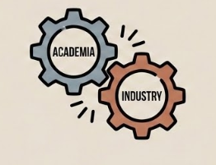
Why Traditional Guidance Fails
Inflexibility
Market
Disconnect
Wellbeing
Blind Spot
12
Notes:
naroa
Current tools have three major flaws.
First, Inflexibility: they fail to detect non-linear patterns. For example, a student who loves both music and math might be perfect for Sound Engineering, but standard tests will just tell them to pick one or the other.
Second, there is a Market Disconnect: many systems are not updated with new and emerging careers, especially in fast-changing technological fields.
But the most critical issue is the Wellbeing Blind Spot. They focus purely on aptitude, what you are good at, but they completely ignore satisfaction. This is why so many people end up in careers they excel at but actually hate, directly contributing to dissatisfaction and dropout rates we see today.

Slide 14



The users/stakeholders: Who We're Building For
Primary: Students
Secondary: Counselors & Parents
Tertiary: Universities & Employers
13
Notes:
aroa
Lo que digo: To understand our impact, we must look at who we are building for.
Our Primary users are students who are facing 'choice paralysis' and need personalized, data-backed guidance.
Secondary stakeholders include parents and counselors, who need objective metrics to support student wellbeing and remove the guesswork from the process.
Finally, we provide massive value to Universities and Employers. By ensuring a genuine 'Person-Environment Fit,' we help them drastically reduce dropout rates and hire professionals who are actually aligned with their roles."
Our solution targets three main groups: First, students, who need personalized guidance. Second, counselors and parents, who want objective data. And third, universities and employers, who want better alignment and lower dropout rates.
Pre-university or university students with doubts seeking data-validated, personalized career recommendations.
School counselors and families seeking objective data to reduce uncertainty and support student wellbeing.
Institutions seeking to reduce dropout rates and hire professionals with genuine Person-Environment Fit.

Slide 15
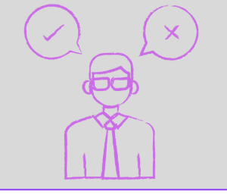


Three Main Problems, That we will solve…
1
2
3
Decision Fatigue
Rigid Rule-Based Models
Aptitude ≠ Satisfaction
14
Notes:
aroa
Lo que digo: We solve this through three key technical innovations:
First, we tackle Decision Fatigue. Traditional 200-question tests are mentally exhausting. Research proves that halfway through these monotonous forms, students stop reflecting and start answering randomly just to finish. This creates 'dirty data’ noise that makes any final result statistically unreliable.
Second, we move past Rigid Rule-Based Models. Most existing tools still rely on simple 1990s arithmetic: This is dangerously oversimplified. It’s too rigid for today’s world
Lastly, we recognize that Aptitude does not equal Satisfaction. is assuming that being good at something means you should do it for life. We’ve all heard it:' But technical skill does not guarantee professional happiness. This logic ignores the risk of burnout and leads to students choosing careers they will eventually abandon.
We are here to change this. We solve these three systemic flaws through three key technical innovations that Encina will now explain.
2- Instead of monotonous 200-question tests, we use a two-stage hierarchical survey that only asks specialized questions once a profile begins to emerge.
3- Being good at math doesn't mean you'll enjoy being an accountant. Our parallel regression model predicts a long-term Satisfaction Index, ensuring students choose careers they will actually stay in."
We identified three core problems: Decision fatigue, Rigid models, And lack of satisfaction prediction. And we translate each into a technical solution:
a hierarchical survey, neural networks for complex patterns and a model that predicts a satisfaction index. All of this leads us to the final definition of the problem.
Traditional tests sum points linearly, missing complex hybrid profiles. Solution: Likert-scale feature vectors (1–5) fed into Neural Networks to detect non-linear patterns.
Students pick careers they're good at, not ones they'll enjoy — driving dropout.Solution: Parallel regression model predicting a long-term Satisfaction Index (0–100%).

Slide 16


problem to be solved
The lack of vocational guidance tools that integrate multi-stage quantitative data analysis and the prediction of subjective satisfaction, can lead to dropout or poor career choices based on incomplete information or decision fatigue.
OUR SOLUTION: ORIENT AI
15
Notes:
encina
we have adknoledge that theres a lack of a guiding tool that truly integrates quantitative data analysis with something as human as personal satisfaction.
At Orient AI, we don't just offer advice; we're proposing a Machine Learning-Based Recommendation System that replaces intuition with mathematical precision.

Slide 17




ORIENT AI
Data Input optimization
Nonlinear Model
Career + Score
Cascading surveys :
Level 1: Scope → Level 2: Specialty
multi-class classification model can identify profiles traditional tests miss
Not only suggests a career path but also quantifies the probability of the user feeling satisfied
16
Notes:
encina
what does o ai involve?
Our primary competitive advantage is data input optimization. instead of endless tests generate fatigue and bias, we implement a cascading survey architecture (Level 1: Scope / Level 2: Specialty). We filter out noise from the very first level so that every data vector entering our model is of high quality, guaranteeing a much finer and more specific classification.
At the heart of Orient AI, there’s a multi-class classification model (like Random Forest and XGBoost) that will process data vectors and detects through non-linear ecutions, correlations not seen by the human eye. The true competitive advantage of this model is its ability to identify latent correlations and internal structures in the data that are virtually imperceptible to the human eye. While a traditional career advisor might rely on linear trends or subjective experiences, Orient AI uses nonlinear decision functions to:
Map complex interconnections: Detect how seemingly unrelated variables (such as problem-solving habits, specific personality traits, and technical preferences) converge to indicate an aptitude for a particular career.
Identify multidimensional patterns: The model navigates high-dimensional spaces to find "clusters of success," recognizing that career affinity is not the result of a single factor, but rather a complex data architecture.
But the real differentiating factor is our Parallel Regression Model. We not only predict where the student should go, but also how long they will want to stay there. We quantify the Probability of Satisfaction, we are not just looking for academic success, but for professional sustainability. With Orient AI, students not only discover what they're good at, but also where they'll truly thrive.

Slide 18
ANY QUESTIONS ?
Notes:
And with that, we would be happy to answer any questions.

